Slide 1
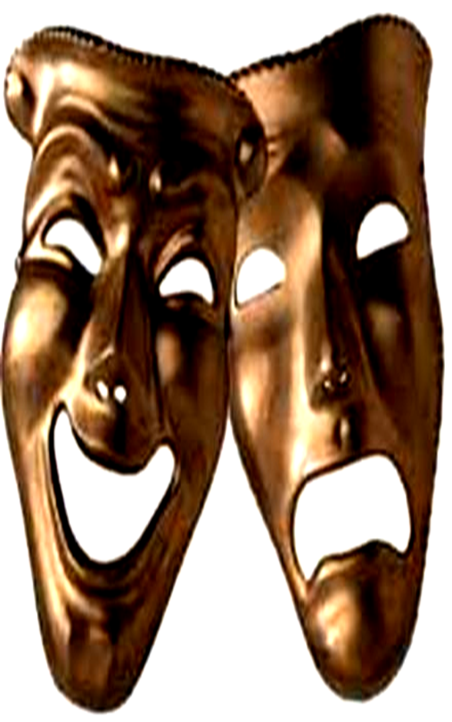
POPULAR ART EXPRESSIONS
VISUAL ARTS
Is the kind of art form that the population is most likely more exposed to, but its variations are so diverse they range from sculptures that you see in art galleries to the last movie you saw. Some mediums of visual arts include paintings, drawings, lettering, printing, sculptures, digital imaging, and more.

Slide 2
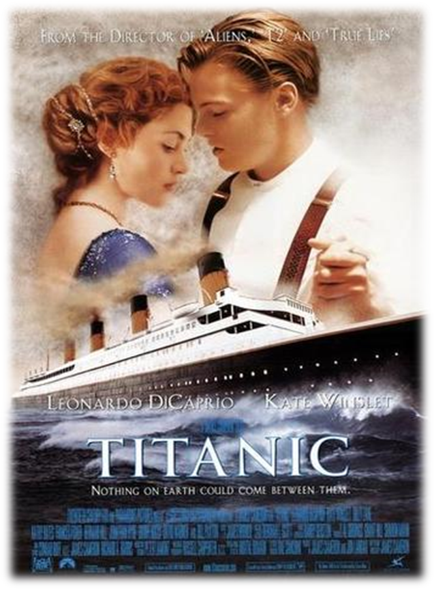
POPULAR ART EXPRESSIONS
FILM
Film refers to the art of putting together successions of still images in order to create an illusion of movement, Filmmaking focuses on its aesthetic, cultural, and social value and is considered as both an art and an industry.

Slide 3
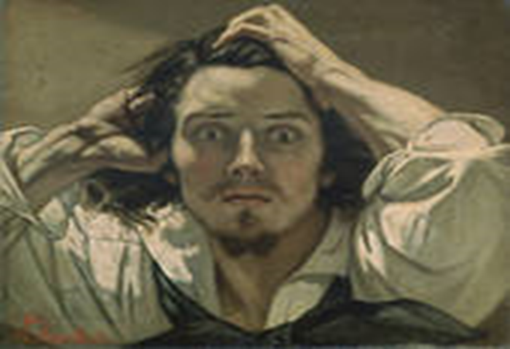
POPULAR ART EXPRESSIONS
Performance Art
Performance art is a live art and the artist’s medium is mainly the human body which he or she uses to perform, but also employs other kind of art such as visual art, props, or sound.

Slide 4
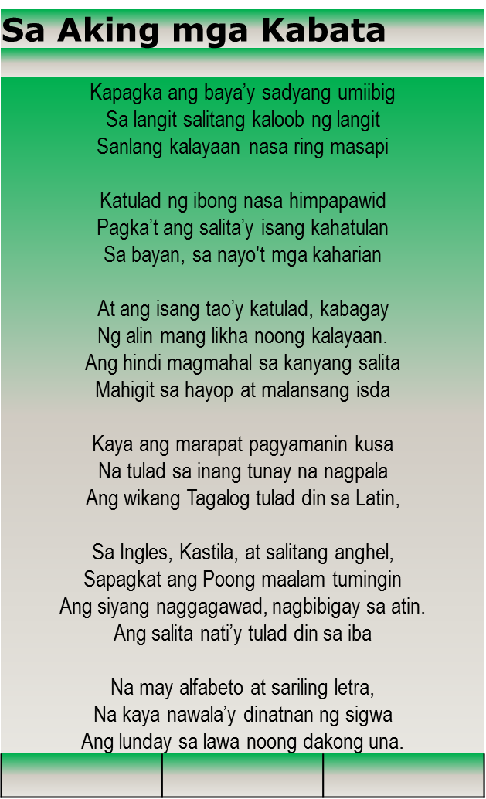
POPULAR ART EXPRESSIONS
Poetry Performance
Poetry is an art form where the artist expresses his emotions not by using paint, charcoal, or camera, but expresses them through words.

Slide 5
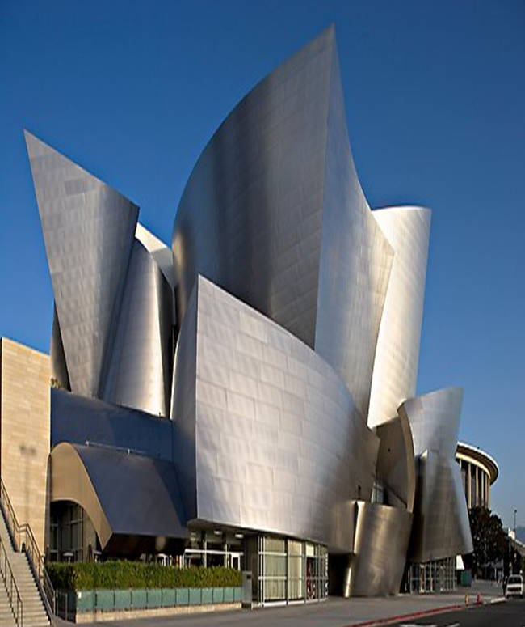
POPULAR ART EXPRESSIONS
Architecture
Architecture – is the art of designing and constructing buildings and other types of structures.
It is often referred to as the “mother of the arts” because it houses, serves as background for, or occurs in relation to other fields of art.
Materials used include stone, concrete, brick, wood, steel, glass, and plaster.

Slide 6
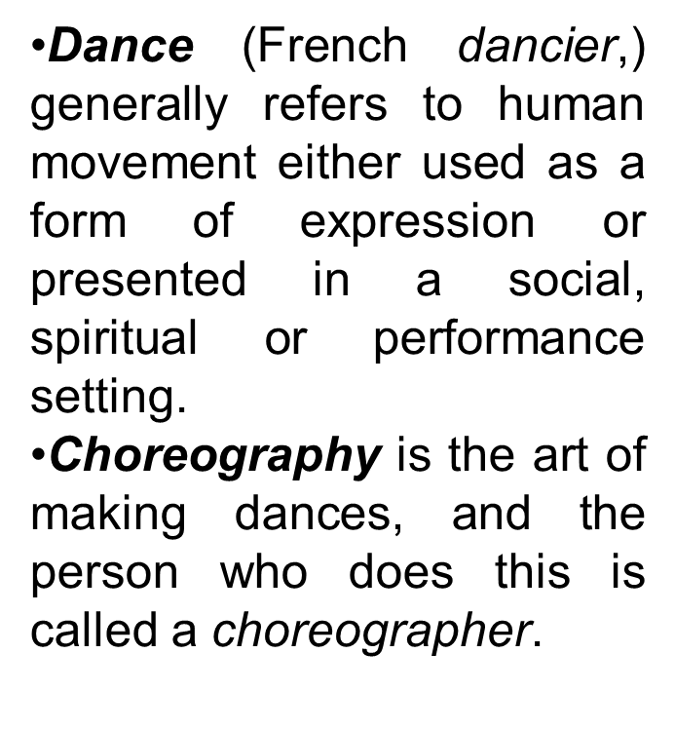
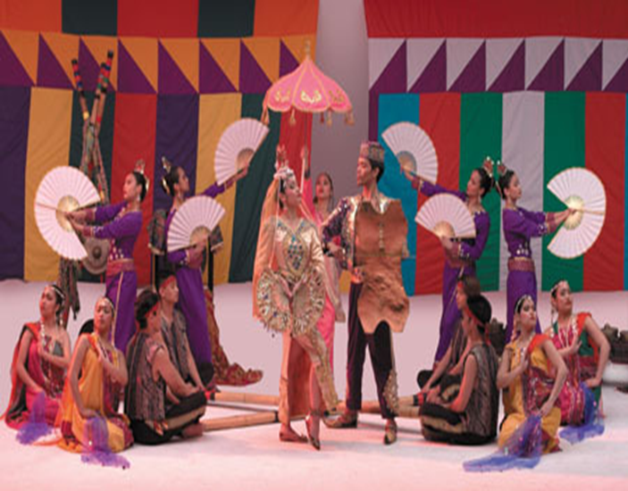
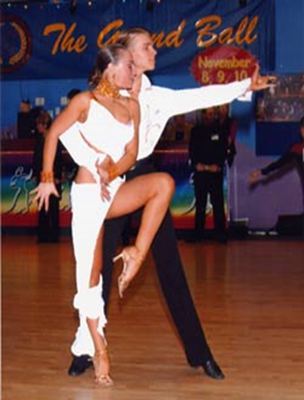
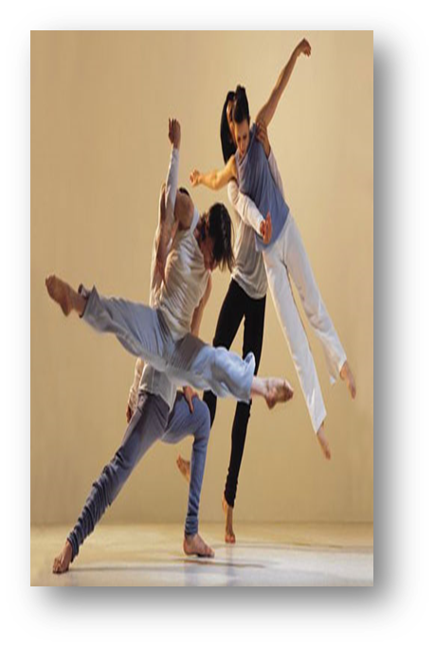
POPULAR ART EXPRESSIONS
Dance
Dance is series of movements that follows the rhythm of the music accompaniment.

Slide 7
POPULAR ART EXPRESSIONS
Literary Art
Literary art goes beyond the usual professional, academic, journalistic, and other technical form of writing. It focuses on writing using a unique style, not following a specific form or norm. It may include both fiction and non-fiction such as novels, biographies and poems.

Slide 8
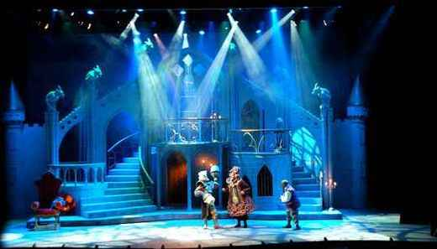
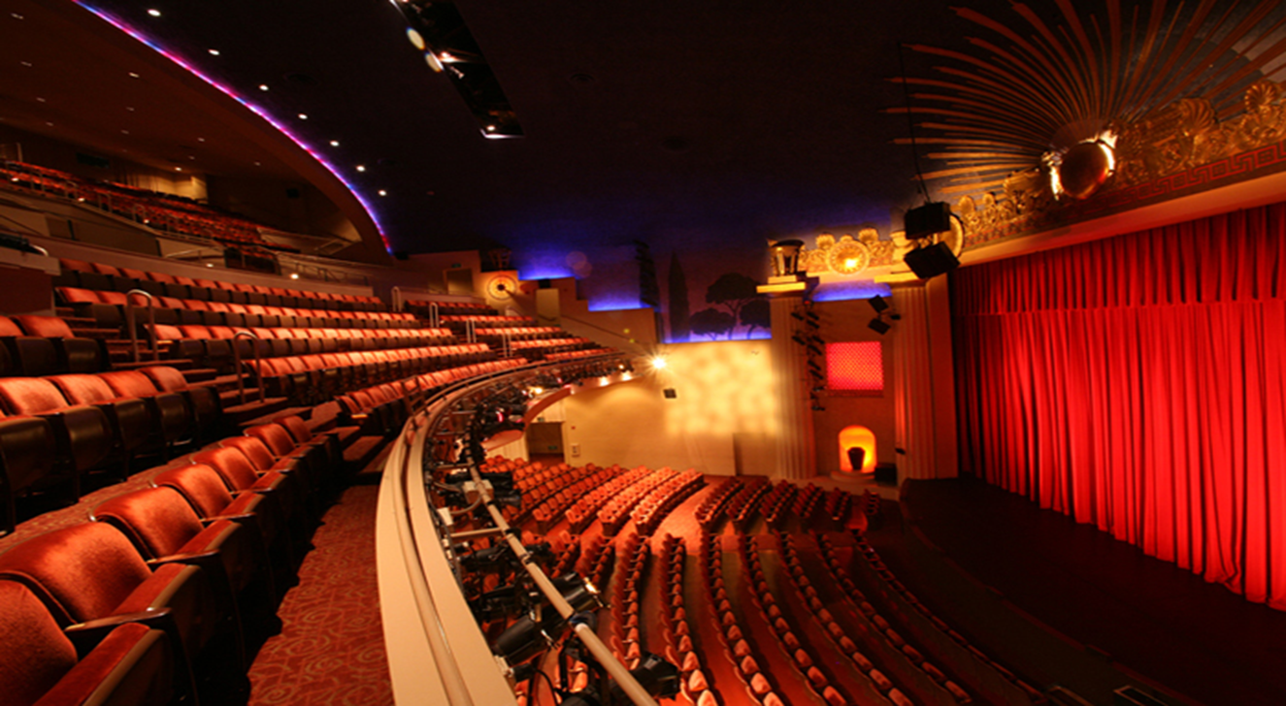
POPULAR ART EXPRESSIONS
Theater
Theater uses live performers to present accounts or imaginary events before a live audience. Theater art performance usually follows a script, though they should not be confused with literary arts.

Slide 9
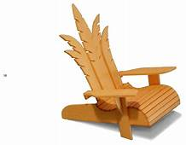
POPULAR ART EXPRESSIONS
Applied Arts
Applied arts incorporate elements of style and design to everyday items with the aim of increasing their aesthetical value. Artists in this field bring beauty, charm, and comfort into many things that are useful in everyday life.

Slide 10
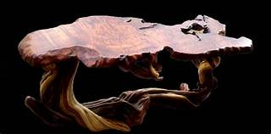
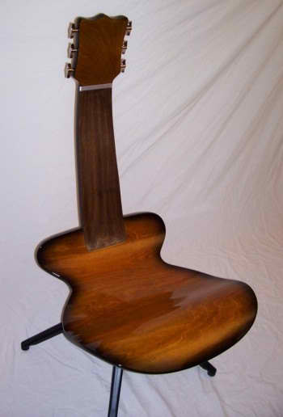
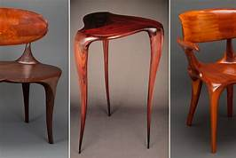
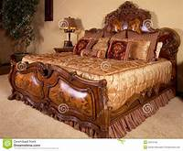
POPULAR ART EXPRESSIONS
Applied Arts

Slide 11
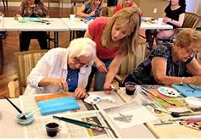
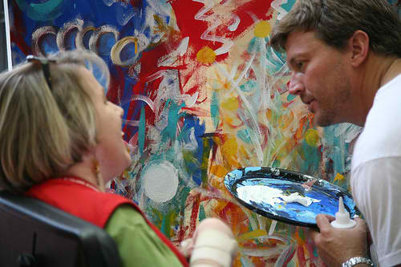
THE FUNCTIONS OF ART
A. AS A THERAPY
In its therapeutic function, art can be and is used as therapy for individuals with a variety of illnesses, both physical and mental.

Slide 12
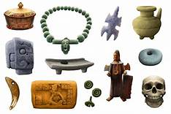
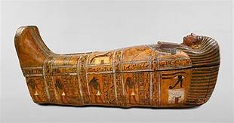
THE FUNCTIONS OF ART
B. ART AS ARTIFACT
Art also functions as an artifact: A product of a particular time and place, an artwork represents the ideas and technology of that specific time and place. As we look back over history, we find in art striking, and in some cases, the only, tangible records of some peoples. The insights we gain into cultures, including our own are enhanced tremendously by such artifacts as paintings, sculptures, poems, plays, and buildings.

Slide 13
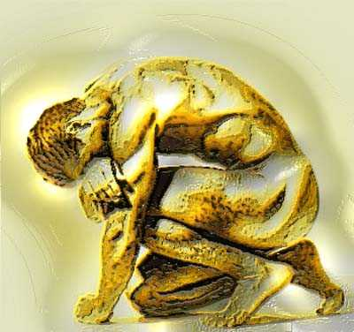
THE FUNCTIONS OF ART
C. PERSONAL FUNCTION OF ART
The personal functions of art are varied and highly subjective. This means that its function depend on the person- the artist who created the art.

Slide 14
THE FUNCTIONS OF ART
D. SOCIAL FUNCTION OF ART
Art is considered to have a social function if and when it addresses a particular collective interest as opposed to a personal interest. Political art is a very common example of an art with a social function. Art may convey message of protest, contestation, or whatever message the artist intends his work to carry.

Slide 15
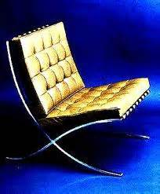
THE FUNCTIONS OF ART
E. PHYSICAL FUNCTION OF ART
The physical functions of art are the easiest to spot and understand. The physical functions of art can be found in artworks that are crafted in order to serve some physical purpose.

Slide 16
THE FUNCTIONS OF ART
F. Other Functions of Art
Music as an art is also interesting to talk about in relation to function. Music in its original form was principally functional. Music was used for dance and religion. Unlike today, when one can just listen to music for the sake of music’s sake, the ancient world saw music only as an instrument to facilities worship and invocation to gods. Music also was essential to dance because music assures synchronicity among dancers.

Slide 17
THE FUNCTIONS OF ART
F. Other Functions of Art
Art as a Representation
Art as a Disinterested Judgment
Art as a Communication of Emotion

Slide 18
SUBJECT AND CONTENT
Subject refers to the visual focus or the image that may be extracted from examining the artwork.
WHAT?
Content is the meaning that is communicated by the artist or the artwork.
WHY?

Slide 19
TYPES OF SUBJECT
Representational art
These types of art have subjects that refer to object or events occurring in the real world. Often, it is also termed figurative art, because as the name suggest, the figures depicted are easy to makes out and decipher.

Slide 20
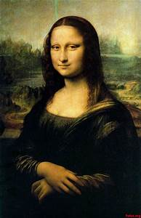
TYPES OF SUBJECT
Representational art

Slide 21
TYPES OF SUBJECT
Non-Representational art
This art does not make a reference to the real world, whether it is a person, place, thing, or even a particular event. It is stripped down to visual elements such as shapes, lines, emotion, and even concept.

Slide 22
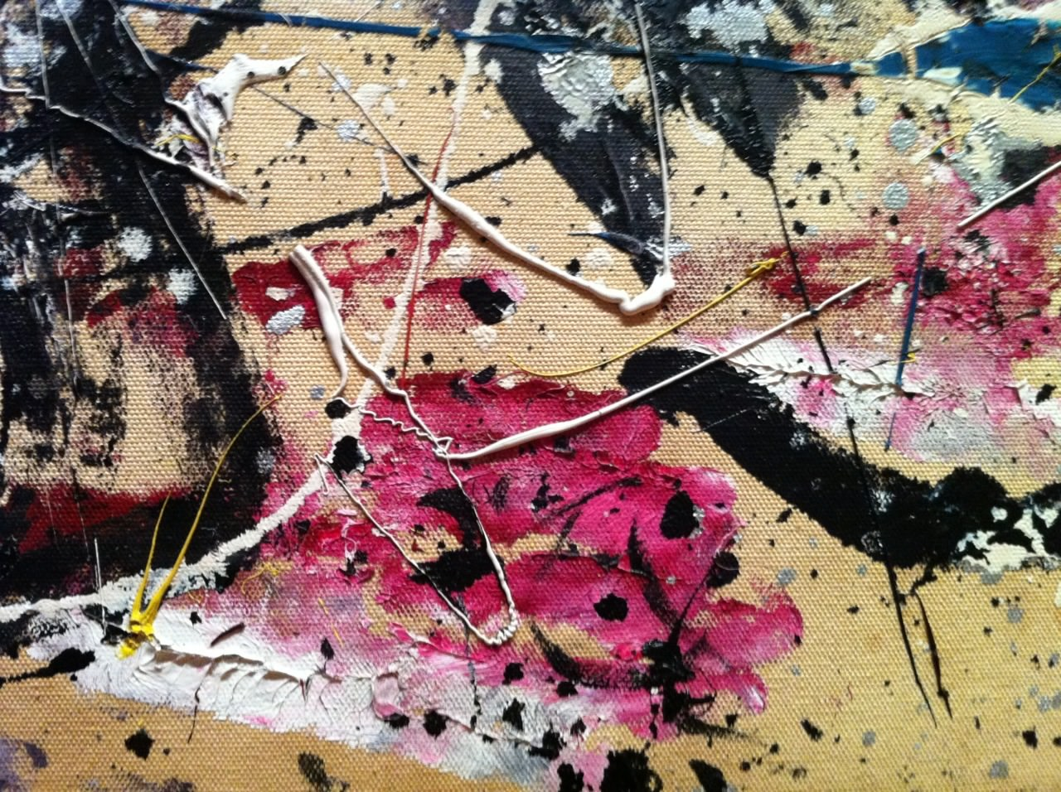
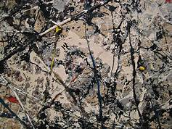
TYPES OF SUBJECT
Non-Representational art
Jackson Pollock, detail of “Number 1A”

Slide 23
Sources of Subject
NATURE
Sacred Oriental Texts
HISTORY
Other works of art
Greek and Roman Mythology
Judeo- Christian Tradition

Slide 24
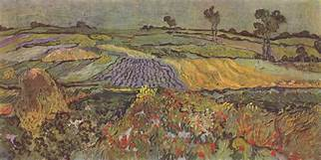
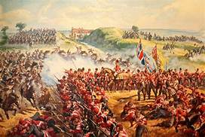
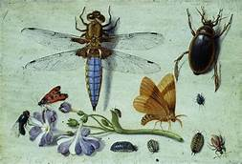
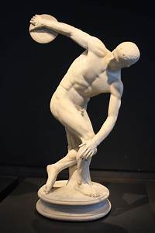
Sources of Subject
NATURE
Vincent van Gogh "Die Ebene von Auvers"
Battle of Waterloo
HISTORY
Greek and Roman Mythology
“Discobolus” – Greek original by the sculptor Myron of 450-440 BC

Slide 25
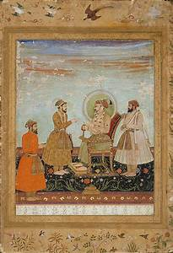
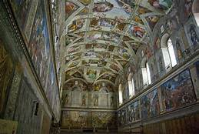
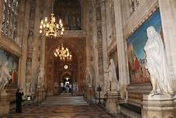
Sources of Subject
Sacred Oriental Texts
Judeo- Christian Tradition
“"Shah Jahan Receiving Dara Shikoh"
“Interior of Westminster
“Sistine Chapel” – Michelangelo

Slide 26
Kinds of Subject
History
Landscape
STILL LIFE
CITYSCAPE
Seascape
ANIMALS
Figures
Mythology
Nature
Myth
Dreams
FANTASIES

Slide 27
CONTENT IN ART
Levels of meaning
FACTUAL
SUBJECTIVE
CONVENTIONAL

Slide 28
CONTENT IN ART
Levels of meaning
Factual pertains to the most rudimentary level of meaning for it may be extracted from the identifiable or recognizable forms in the artwork and understanding how these elements relate to one another.

Slide 29
CONTENT IN ART
Levels of meaning
Conventional meaning, on the other hand, pertains to the acknowledged interpretation of the artwork using motifs, signs, symbols and other cyphers as bases of its meaning. These conventions are established through time, strengthened by recurrent use and wide acceptance by its viewers or audience and scholars who study then.

Slide 30
CONTENT IN ART
Levels of meaning
When subjectivities are consulted, a variety of meaning may arise when a particular work of art is read. These meanings stem from the viewer’s or audience’s circumstances that come into play when engaging with art.

Slide 31
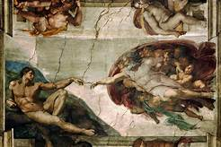
CONTENT IN ART
Subjective
“Creation of Adam” by Michelangelo at Sistine Chapel

