Slide 1
Principles of Design
Prof. Victor L. Felicia
Our lady Of Fatima University

Slide 3
Principles of Design refer to the visual strategies used by artists, in conjunction with the elements of arts – for expressive purposes (Fichner-Rathus, 2008).

Slide 4
They include:
Harmony
Unity
Balance
Simplicity
Rhythm
Clarity
Emphasis
Contrast
Proportion
Variety

Slide 6
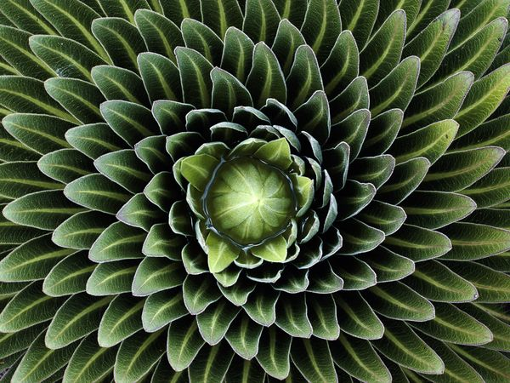
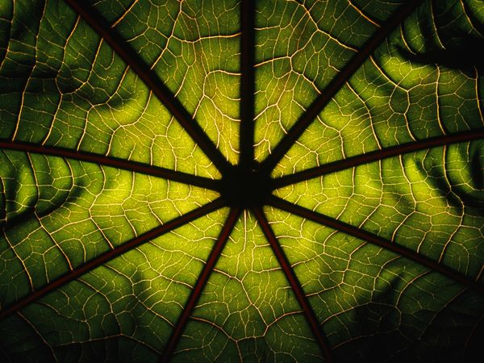
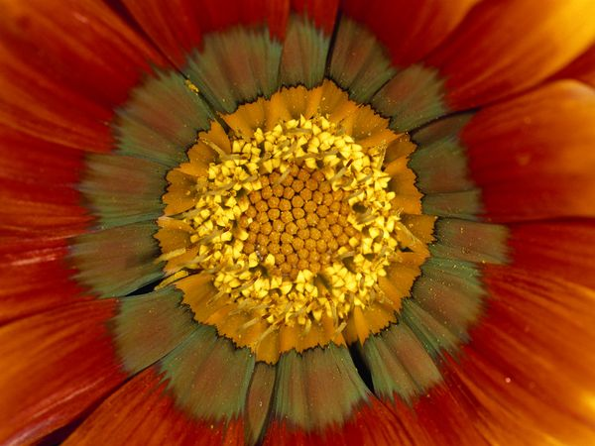
draw and hold the viewer’s eye on certain parts of a work
bring visual stability
add visual interest to a composition
convey a sense of orderly progression

Slide 7
How we apply the principles of design determines how successful we are in creating a work of art.

Slide 8
PRE-ACTIVITY
Directions: Identify the principle of design
that is best applied in each of the given
visuals.

Slide 9
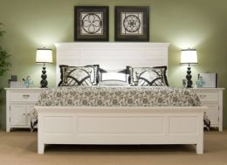
Visual 1

Slide 10
Which principle of design is shown in Visual 1?
Harmony
Balance
Rhythm
Emphasis

Slide 11
Which principle of design is shown in Visual 1?
Harmony
Balance
Rhythm
Emphasis

Slide 12
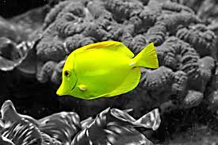
Visual 2

Slide 13
Which principle of design is shown in Visual 2?
Balance
Rhythm
Proportion
Emphasis

Slide 14
Which principle of design is shown in Visual 2?
Balance
Rhythm
Proportion
Emphasis

Slide 15
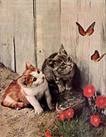
Visual 3

Slide 16
Which of the principles of design is shown in Visual 3?
Balance
Contrast
Emphasis
Variety

Slide 17
Which of the principles of design is shown in Visual 3?
Balance
Contrast
Emphasis
Variety

Slide 18
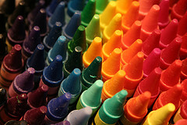
Visual 4

Slide 19
Which principle of design is shown in Visual 4?
Rhythm
Harmony
Unity
Variety

Slide 20
Which principle of design is shown in Visual 4?
Rhythm
Harmony
Unity
Variety

Slide 21
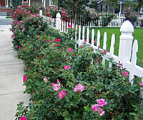
Visual 5

Slide 22
Which principle of design is shown in Visual 5?
Harmony
Rhythm
Proportion
Balance

Slide 23
Which principle of design is shown in Visual 5?
Harmony
Rhythm
Proportion
Balance

Slide 24
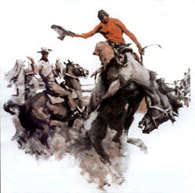
Visual 6

Slide 25
Which principle of design is shown in Visual 6?
Emphasis
Balance
Simplicity
Contrast

Slide 26
Which principle of design is shown in Visual 6?
Emphasis
Balance
Simplicity
Contrast

Slide 27
HARMONY
Harmony in visual design means all parts of the visual image relate to and complement each other.

Slide 28
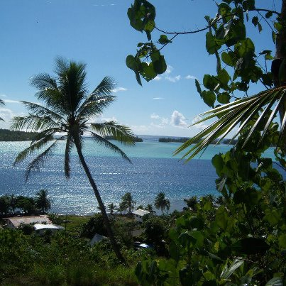
Harmony is the visually satisfying effect of combining similar or related elements.

Slide 30
RHYTHM
is organized movement, a beat, a repetition.
is created by repetition, and repetitive patterns convey a sense of movement.
in the visual arts, the viewer perceives rhythm by grouping elements such as color, line and shape.

Slide 31
Rhythmical patterns help the eye to move easily from one part of the room to another or from one part of a design to another (Sanchez, et al., 2009).

Slide 32
Regular Repetition
A means of creating rhythm in which elements of a composition are duplicated at orderly or fixed intervals.
The easiest and most precise way to create rhythm.
Regular repetition was
a core property of Minimalist artists, of which Flavin was one.
Dan Flavin. Untitled (to Jan and Ron Greenberg), installation view at the Dan Flavin Art Institute, Bridgehampton, NY. (1972–73) Fluorescent light (96”x96”).

Slide 33
Regular Repetition
Donald Judd’s sculpture in particular was based on the repetition of simple geometric shapes mounted on walls or set on the floor in a steady, evenly spaced pattern.
Minimalism. An abstract art movement begun in the 1960s that emphasizes the use of pure
and simple shapes and materials.

Slide 34
Alternating Rhythm
a type of rhythm in which different elements in a work repeat themselves in predictable order.

Slide 35
Progressive Rhythm
Minor variations in rhythm can add interest to a composition.
Such variations are seen in progressive rhythm, in which the rhythm of elements of a work of art such as shape, texture, or color change slightly as they move, or progress toward a defined point in the composition.

Slide 36
Balance
Balance is the concept of visual equilibrium, and relates to our physical sense of balance. It is a reconciliation of opposing forces in a composition that results in visual stability.
Most successful compositions achieve balance in one of two ways: symmetrically or asymmetrically.

Slide 37
In architectural works like the United States Capitol – the house in which the laws of the land are created – repetition and symmetry can imply rationality and decorum, tying the structure of the building to a certain symbolic ideal.

Slide 38
Leonardo da Vinci. Study of
Human Proportion: The
Vitruvian Man (1492) Pen and
Ink drawing (13 ½” x 9 ¾”).

Slide 39
Types of Balance
Symmetrical Balance
Asymmetrical Balance
the type of balance in which the elements of a work are balanced by similarity of form or arrangement on either side of a dividing line or plane, or to correspondence of parts, as in size, shape, or position.
the type of balance in which there are more than slight differences between the divided areas of a work, yet there is an overall sense of balance.
(Fichner-Rathus,2008)

Slide 41
Symmetrical balance can be described as having equal "weight" on equal sides of a centrally placed fulcrum. It may also be referred to as formal balance.
When the elements are arranged equally on either side of a central axis, the result is Bilateral symmetry. This axis may be horizontal or vertical. It is also possible to build formal balance by arranging elements equally around a central point, resulting in radial symmetry.

Slide 42
Balance in a three dimensional object is easy to understand; if balance isn't achieved, the object tips over.
To understand balance in a two dimensional composition, we must use our imaginations to carry this three dimensional analogy forward to the flat surface.

Slide 43
“All emphasis is no emphasis.”
True
False

Slide 44
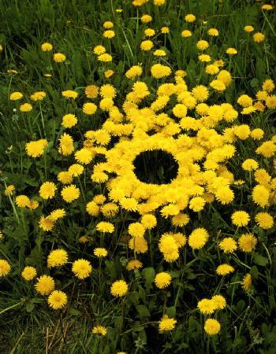

Slide 45
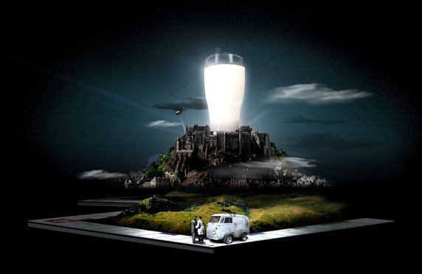
Example of Emphasis
Get the Glass

Slide 46
Emphasis by Directional Lines
Directional lines. Lines that
lead the eye to a focal point.
Oskar Schlemmer Bauhaus Stairway (1932) Oil on canvas (63 7/8” x 45”)

Slide 47
Emphasis by Isolation
Here a group of performers is found standing silently within a barren landscape. Even though there are many of them and they are dressed in their costumes, they are less likely to draw the viewer’s eye than the delicately rendered woman in “street clothes,” who is seated apart in the lower right and looks beyond the edge of the canvas (Fichner-Rathus,2008).
Picasso’s emphasis on the woman’s aloneness draws us
to her along the edge of the canvas (Fichner-Rathus,2008).
Pablo Picasso. Family of Saltimbanques (1905) Oil on canvas (83 3/4” x 90 3/8”).

Slide 48
Unity is a powerful concept.
In art, unity implies harmony. It suggests that the parts of a composition are there by happenstance; rather, they fit together to form a meaningful whole (Fichner-Rathus, 2008).

Slide 49
Unity is powerful, but, as the British writer Aphra Behn said, “Variety is the soul of pleasure.” Without variety, life would comprise a bland sameness, a cookie-cutter existence from which we all shrink. Variety in art, as in life, is seductive. It demands our attention, turns the predictable on edge (Fichner-Rathus, 2008).

Slide 50
PROPORTION
Proportion refers to the relative size and scale of the various elements in a design. The issue is the relationship between objects, or parts, of a whole. This means that it is necessary to discuss proportion in terms of the context or standard used to determine proportions.

Slide 51
CONTRAST

Slide 53
FINAL ACTIVITY
Directions: Identify the principle of design
that is best applied in each of the given
visuals.

Slide 54
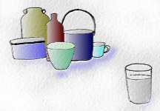
Visual No. 1

Slide 55
Which principle of design is shown in visual 1?
Emphasis by Directional Lines
Emphasis by Isolation
Emphasis by weight

Slide 56
Which principle of design is shown in visual 1?
Emphasis by Directional Lines
Emphasis by Isolation
Emphasis by weight

Slide 57
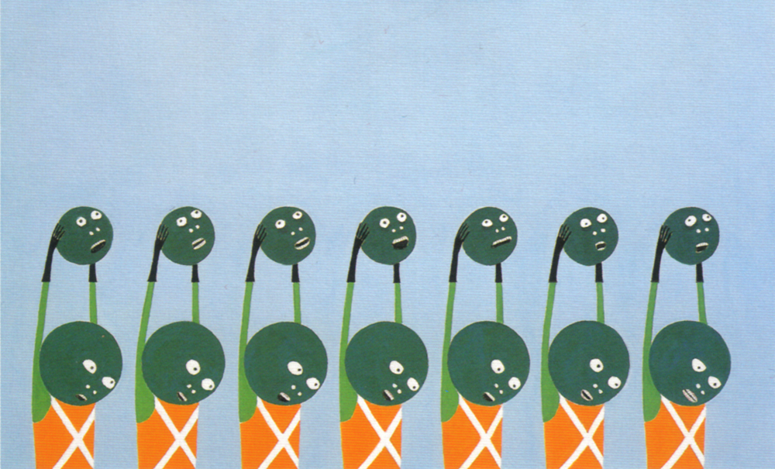
Visual No. 2

Slide 58
Which principle of design is shown in visual 2?
Balance
Emphasis
Proportion
Rhythm

Slide 59
Which principle of design is shown in visual 2?
Balance
Emphasis
Proportion
Rhythm

Slide 60
Visual No. 3

Slide 61
Which principle of design is shown in visual 3?
Contrast
Harmony
Balance
Emphasis

Slide 62
Which principle of design is shown in visual 3?
Contrast
Harmony
Balance
Emphasis

Slide 63
Visual No. 4

Slide 64
Which principle of design is shown in visual 4?
Harmony
Simplicity
Balance
Emphasis

Slide 65
Which principle of design is shown in visual 4?
Harmony
Simplicity
Balance
Emphasis

Slide 66
Visual No. 5

Slide 67
Which principle of design is shown in visual 5?
Balance
Rhythm
Contrast
Emphasis

Slide 68
Which principle of design is shown in visual 5?
Balance
Rhythm
Contrast
Emphasis

Slide 69
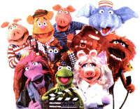
Visual No. 6

Slide 70
Which principle of design is shown in visual 6?
Variety
Balance
Rhythm
Proportion

Slide 71
Which principle of design is shown in visual 6?
Variety
Balance
Rhythm
Proportion

Slide 72
References:
Fichner-Rathus, L. (2008). Foundations of Art and Design. U.S.A:
Thomson Wadsworth.
Sanchez, et al., (2009). Introduction to the Humanities. Rex Bookstore
Inc. Manila.
Patel, J. (2017, October 17) Chasing Dreams: What are you waiting for?
Retrieved from https://visual wildersness.com/business/chasing-
dreams-what-are-you-waiting-for
Pixel Farm (2008, May 9). Various artists, Get the Glass. Retrieved from
http://pixelfarm.blog54.fc2.com/blog-category-10.html
Sanchez, et al., (2009). Introduction to the Humanities. Rex Bookstore
Inc. Manila.

