Slide 1
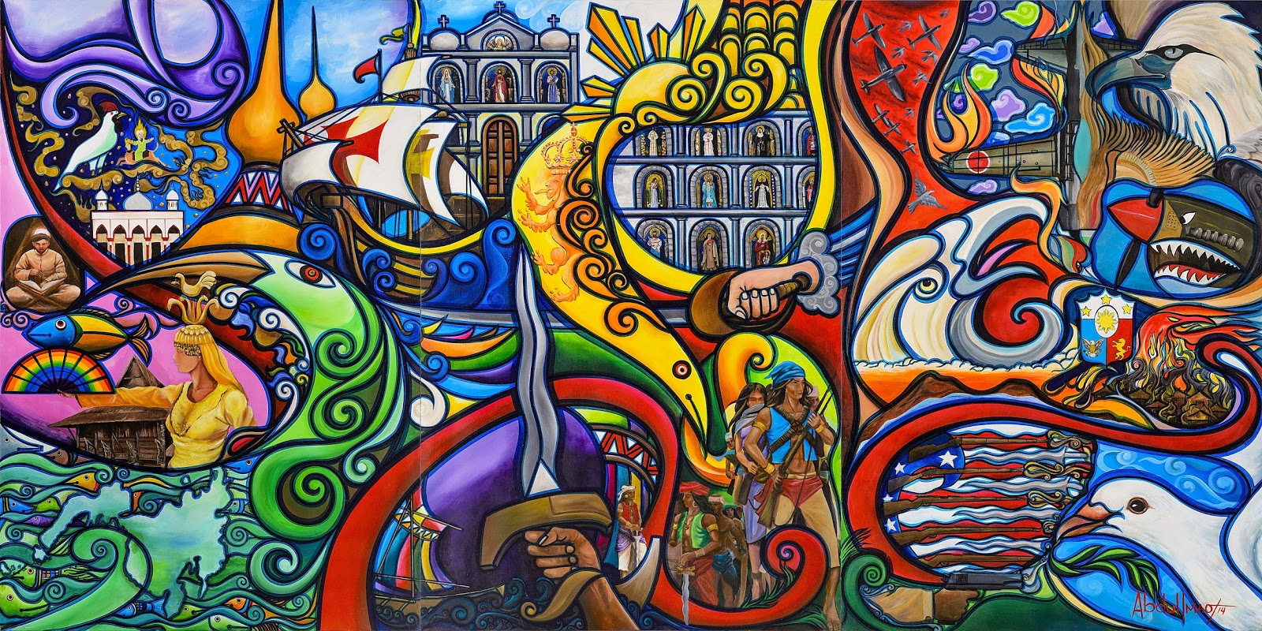
ARTA 111
ART APPRECIATION

Slide 2
Basic Assumptions of the Art

Slide 3
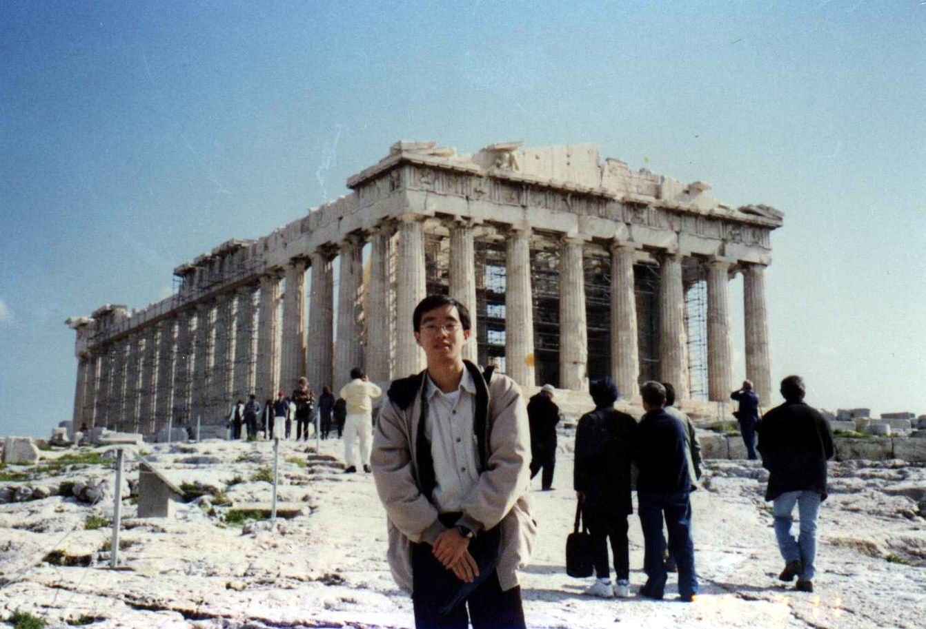
Art has been created by all people at all times, in all countries and it lives because its well-liked and enjoyed

Slide 4
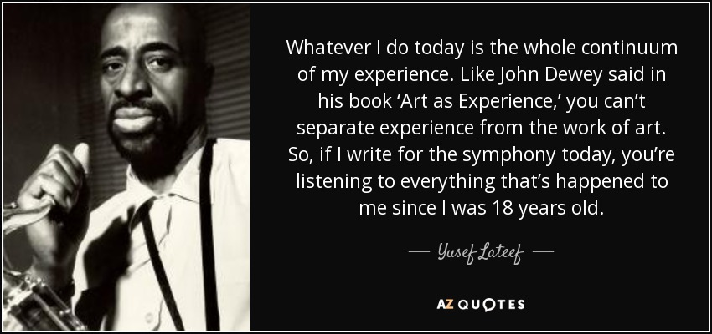
Art involves experience; there can never be appreciation of art without experience.

Slide 5
Art is not nature; Nature is not art.

Slide 6
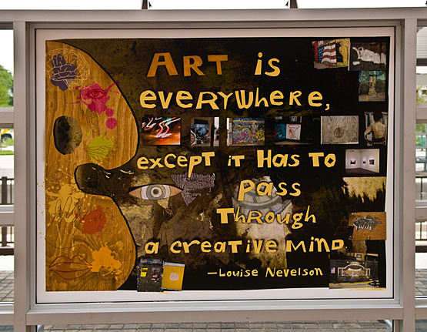
Art is made by man;
Art is everywhere.

Slide 7
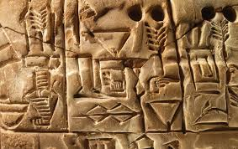
Art is man’s oldest means of expression;
Art as a means of expression & communication.
HIEROGLYPHICS

Slide 8
“The humanities constitute one of the oldest and most important means of expression developed by man”. Human history has witnessed how man evolved not just physically but also culturally, from cave painters to men of exquisite paintbrush users of the present. Even if one goes back to the time before written records of man’s civilization has appeared, he can find cases of man’s attempts of not just crafting tools to live and survive but also expressing his feelings and thoughts. The Galloping Wild Boar found in the cave of Altamira, Spain is one such example. In 1879, a Spaniard and his daughter were exploring a cave when they saw pictures of a wild boar, hind, and bison.

Slide 9
The Galloping Wild Boar found in the cave of Altamira, Spain.

Slide 11
PREHISTORIC PAINTINGS
According to experts, these paintings were purported to belong to Upper Paleolithic Age, several thousands of years before the current era. Pre-historic men, with their crude instruments, already showcased and manifested earliest attempts at recording man’s innermost interests, preoccupations, and thoughts.

Slide 12
The humanities, then, ironically, have started even before the term has been coined. Human persons have long been exercising what it means to be a human long before he was even aware of his being one. The humanities stand tall in bearing witness to this magnificent phenomenon. Any human person, then, is tasked to participate, if not, totally partake in this long tradition of humanizing himself.

