Slide 1
ART APPRECIATION

Slide 3
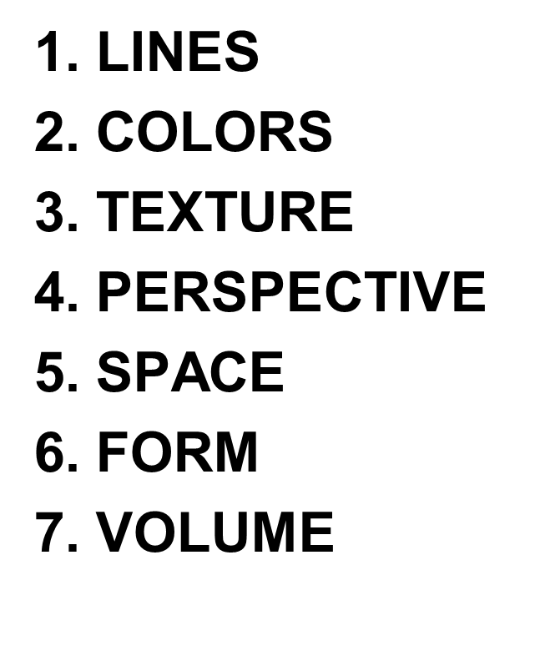
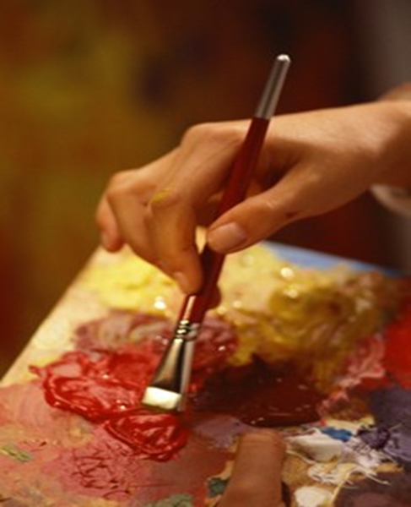
The Elements of Visual Arts

Slide 4
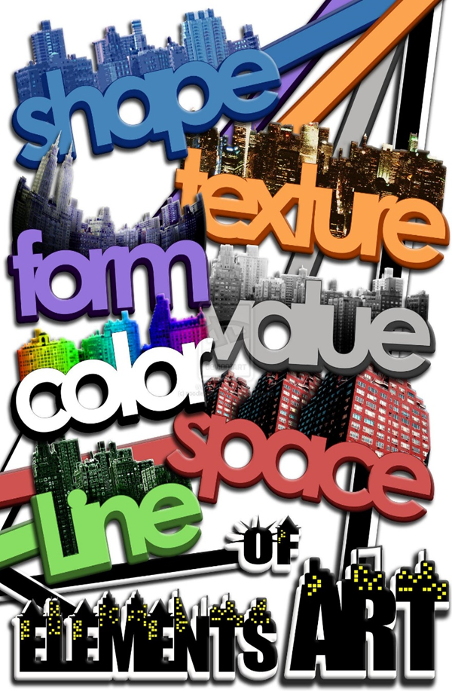
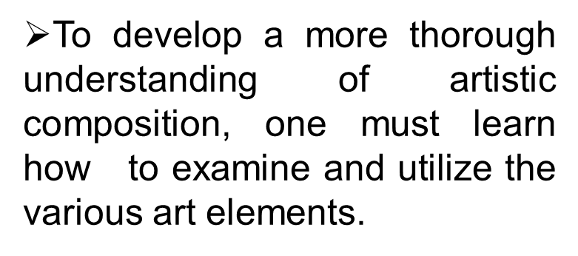
The Elements of Visual Arts

Slide 5
LINE
Line is a mark on a surface that describes a shape or outline. It can create texture and can be thick and thin. Types of line can include actual, implied, vertical, horizontal, diagonal and contour line.

Slide 6
LINE
is an important element at the disposal of every artist.
always has direction, always moving.
as used in any work of art, may either be straight or curved.

Slide 7
Lines are the first element of art and are continuous marks that are made on any surface with a moving point.
Lines can be used in various ways to create different compositions.
A line can be used to express various things or feelings; it can be used to show various moods or anything abstract.

Slide 8
Line serves as an essential building block of art, but it can also serve as the content itself of a work of art, or be manipulated to evoke an emotional or intellectual response from a viewer (Fichner-Rathus, 2010).

Slide 9
What do these lines suggest?
VERTICAL LINES
HORIZONTAL LINES
DIAGONAL LINES
CURVED LINES

Slide 10
Vertical Lines
Vertical lines are poised for action. They are poised, balanced, forceful, and dynamic. They express an impression of dignity.

Slide 11
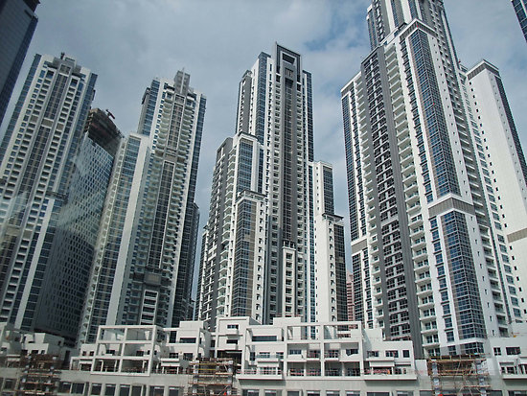
Only vertical lines can be used to express an orderly feeling

Slide 12
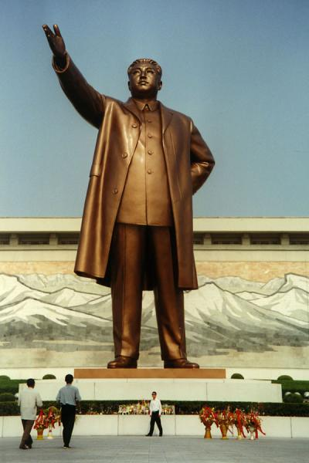
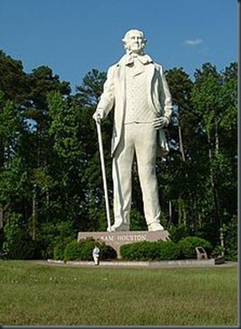
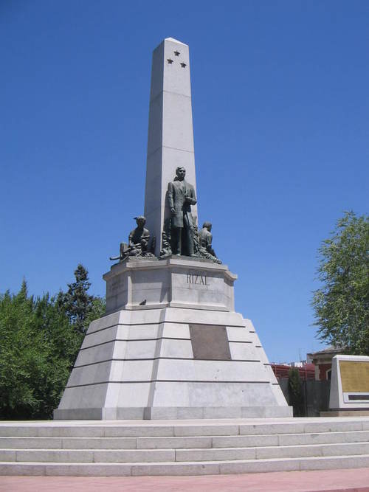
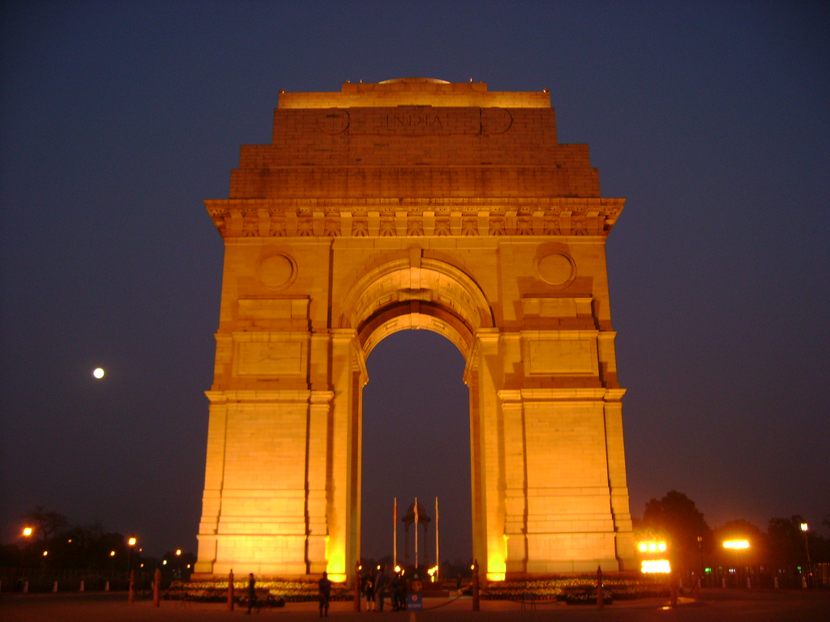
VERTICAL LINES

Slide 13
Horizontal Lines
Horizontal lines are lines of repose and serenity. They express ideas of calmness and quiescence..

Slide 14
Only horizontal lines can give a feeling of peacefulness and stillness.

Slide 15
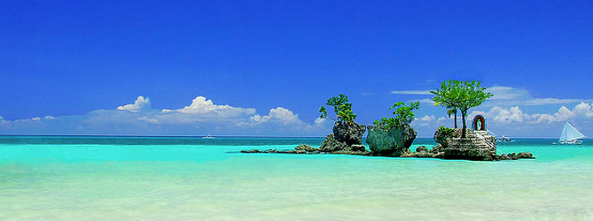
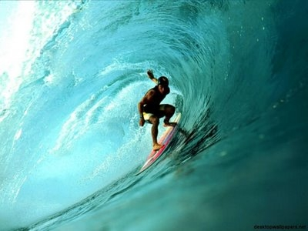
BORACAY
Travel News Philippines: Discovery Shores Boracay gets three awards from Travel + Leisure, Siargao Named 9th best Surfing Spot Worldwide by CNN
SIARGAO

Slide 16
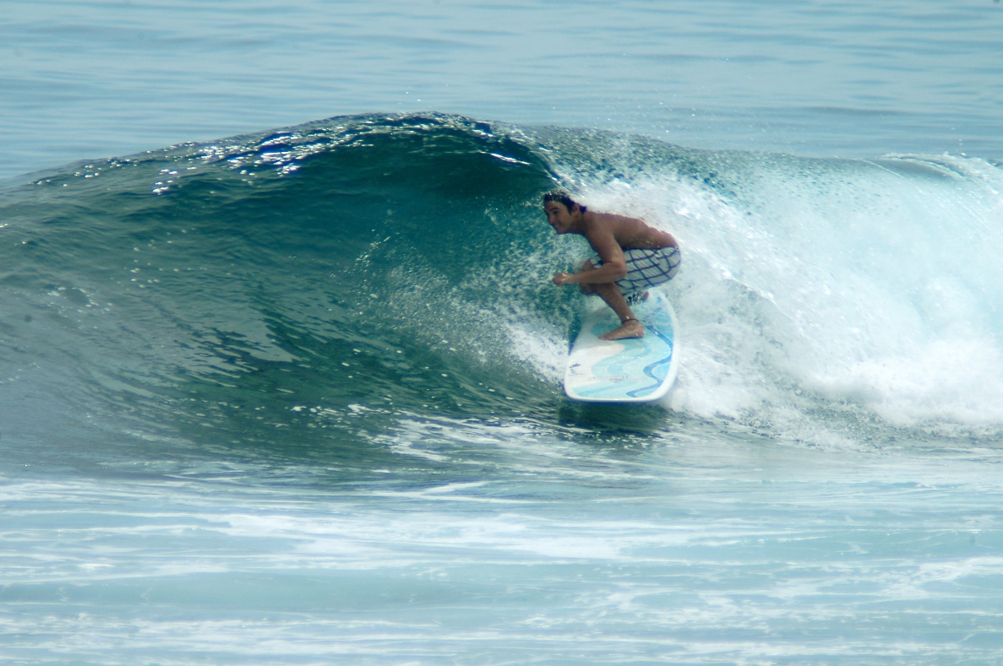
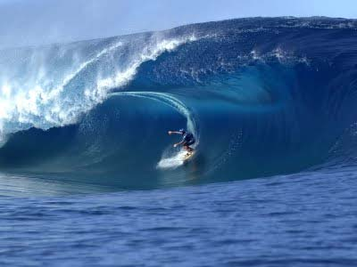
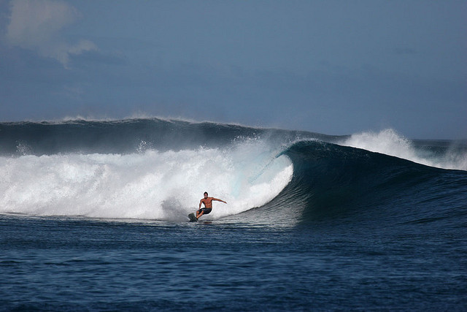
Diagonal lines are used to create feelings of movement or action.
SIARGAO: The Surfing Capital of the Philippines

Slide 17
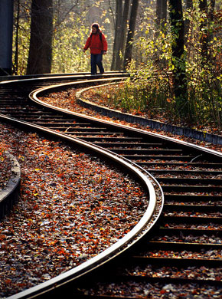
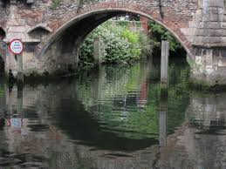
Curved lines, sometimes referred as S curves, suggest gracefulness or sexiness.

Slide 18
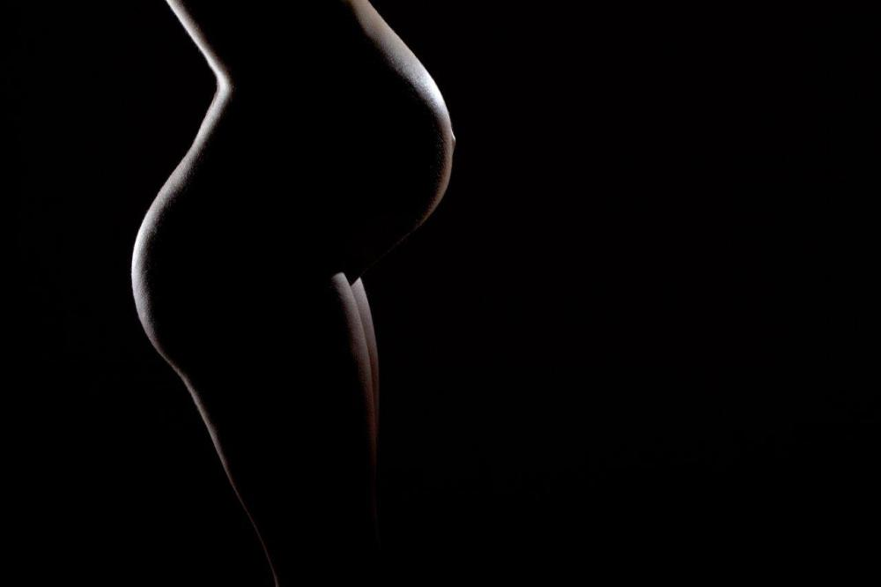
If you want to photograph S curves, the human body makes for a wonderful subject.
From the arch of a foot to the curve of a neck, you can find many ways to capture curved leading lines by photographing the human form.

Slide 19
It is up to the artist how he conveys his message, in the best way possible through the use of lines.

Slide 20
There are various ways to integrate lines into a photograph to help strengthen the overall composition and draw attention to a specific focal point.

Slide 21
ACTIVITY: LEADING LINES IN
PHOTOGRAPHY

Slide 22
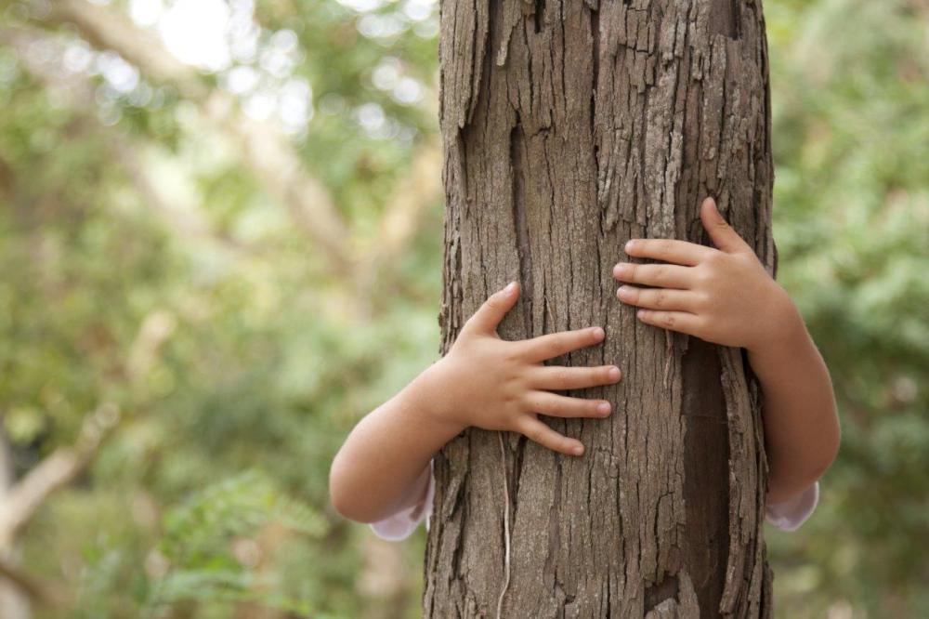
When using vertical lines within a photo, it’s a good idea to follow the rule of thirds, failure to do so can result in a photo looking as though it’s been cut in half. It is also important to try to keep the vertical line as straight as possible. Vertical leading lines can help to illustrate growth, authority, strength, or dominance. Some examples of vertical leading lines in photography include photographs of trees or tall buildings.

Slide 23
When composing your photo to include horizontal leading lines, make sure they’re as straight as possible and consider following the rule of thirds. This photo, for example, places the land and horizon along the bottom third of the image, while the sky fills the top two-thirds of the shot. Further, the photo was composed so the bride and groom are along the left-third of the image.

Slide 24
This photo uses both horizontal and vertical lines. Although the bulrushes are the obvious use of vertical lines, the horizontal line of the horizon is more subtle. Note, too, that the photo has been composed so the landscape follows the rule of thirds.

Slide 25
Curved lines, sometimes referred as S curves, can help lead the eye through a photo and can suggest gracefulness, sexiness, or sensuality. Despite the name, S curves don’t need to be shaped exactly like an “s.” Any strong leading line that winds or curves can be considered an S curve. Some curved leading lines often used in photography include paths and rivers.

Slide 26
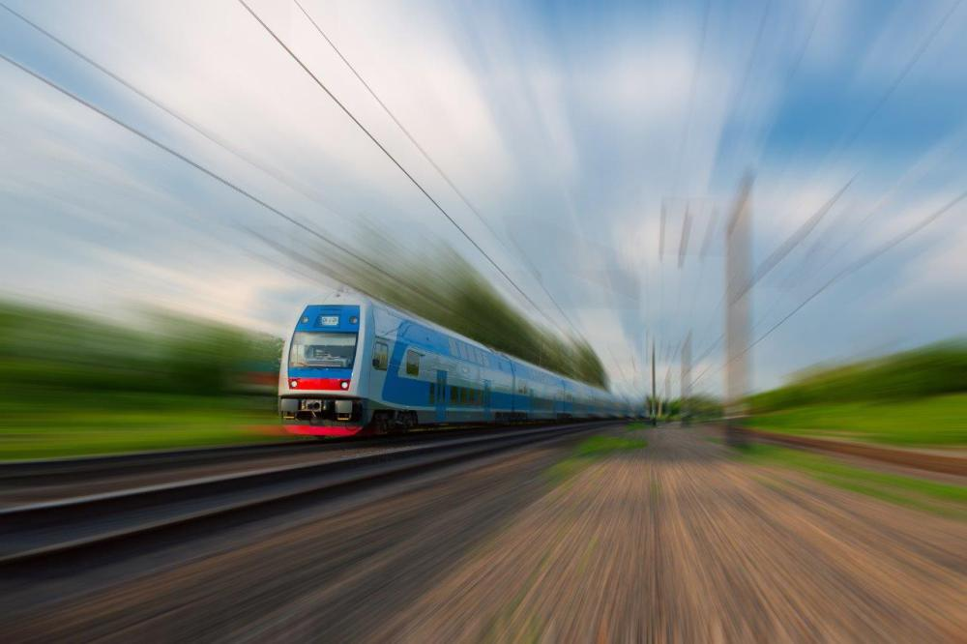
When including diagonal leading lines within a photo, it’s best if you can position them so that they start and finish just above or below the corner of a photo, like the railroad tracks shown here. This will prevent the image from looking like it has been split in half. Because our eyes naturally scan photos from left to right, composing an image to include diagonal leading lines that flow from the bottom left to the top right of a photo is also a great way to compose a shot.

Slide 27
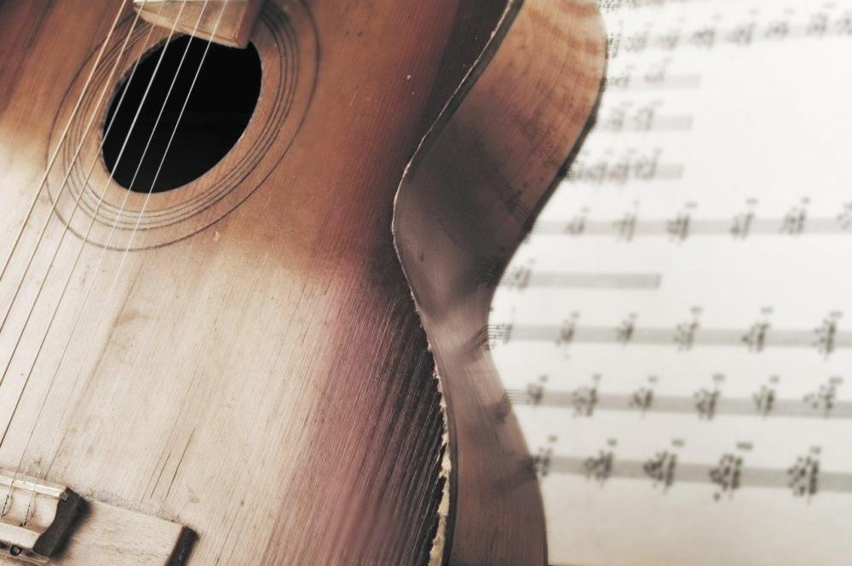
The body of this acoustic guitar is a great example of S curves. Note the use of other leading lines in this photo too – the diagonal lines of the guitar strings, and the horizontal lines of the sheet of music in the background.

Slide 28
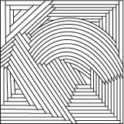
Three Main Types of Lines
Repetition occurs when two or more lines are drawn within a corner following the lines of the corner.

Slide 29
Three Main Types of Lines
Lines that are in opposition to each other form a contrast.

Slide 30
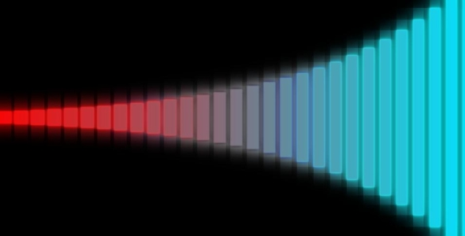
Three Main Types of Lines
A transition line is a line that connects two workflow elements. Transition lines allow you to define what the next step in a workflow will be.

Slide 31
To summarize, including leading lines within a photograph is a composition technique that can strongly influence the overall result of an image.
Leading lines can direct a person’s eye to a main focal point or, if used incorrectly, can draw the eye away from the subject or appear to cut a photo in half.

Slide 32
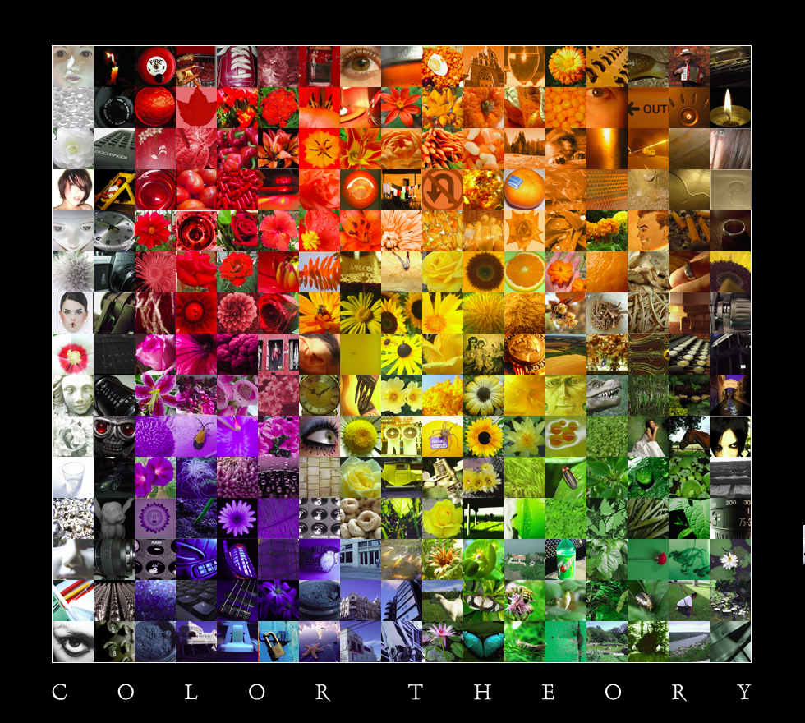
The Art Element of Color
Color refers to the visual perception of light being reflected from a surface of an artwork.

Slide 33
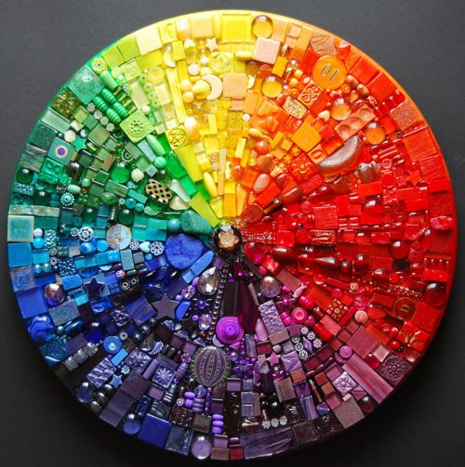
In the most basic classification, colors can be divided into three groups: primary, secondary and tertiary.

Slide 34
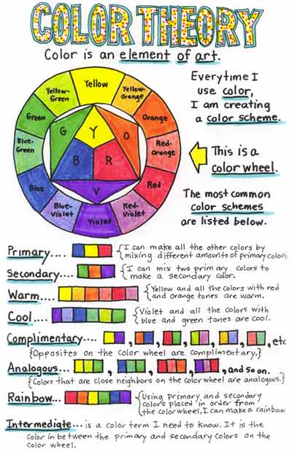

Slide 36
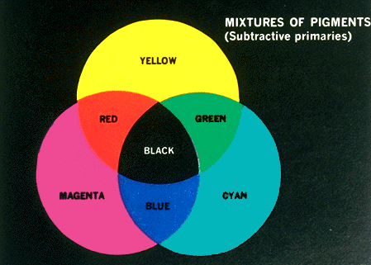
Attributes of Color
Hue is the term for the pure spectrum colors commonly referred to by the "color names" - red, orange, yellow, blue, green violet - which appear in the hue circle or rainbow. Theoretically all hues can be mixed from three basic hues, known as primaries.

Slide 37
Color Wheel
A color wheel is an abstract illustrative organization of color hues around a circle, that shows relationships between primary, secondary, and tertiary colors, etc.

Slide 38
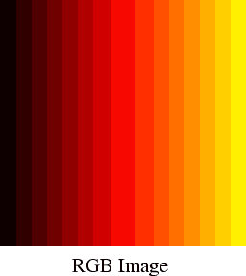
Attributes of Color
Value refers to the lightness or darkness of a color. It is the quality which depends on the amount of light and dark in color.

Slide 39
Attributes of Color
Tints are values above the normal
Shades are values below the normal.
Intensity refers to the brightness or darkness of color. It gives color strength. When a hue is vivid form, it is said to be in full intensity. When it is dulled, it is said to be partly neutralized.

Slide 40
Psychology of Colors
Colors have varied psychological and emotional connotations.
Black is associated with death and gloom
White stands for purity and innocence
Red is associated with blood, anger and fear
Green implies happiness and abundance

Slide 41
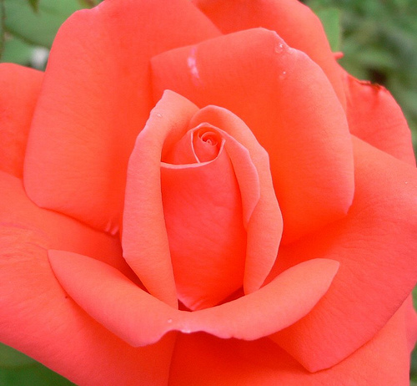
Meanings of Colors Conveyed by the Rose
Red is for “I love you”
Pink conveys “Thank you”
White says “You are heavenly”
Coral speaks of desire.
White roses denote secrecy, reverence and humility.
Deep pink roses convey gratitude and appreciation.
Light pink express sympathy, grace and gentility
Red roses also mean courage and fortitude
Yellow roses stand for freedom
Red and Yellow stand for jovial /happy feelings
Orange roses speak of enthusiasm and desire
Red and White convey unity

Slide 42
TEXTURE

Slide 43
is the element that deals more directly with the sense of touch.
applies to how an object feels or appears to feel.
can be either implied or actual.

Slide 44
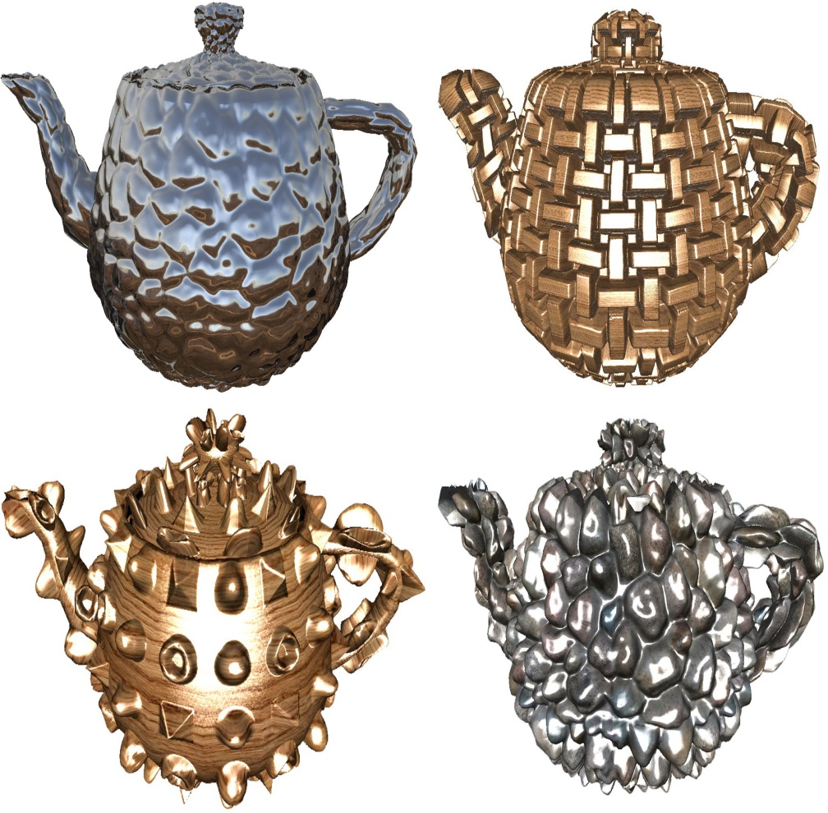
texture
Texture is the element that deals more directly with the sense of touch.
It has to do with the characteristics of surfaces which can be rough or smooth, fine or coarse, shiny or dull, plain or irregular.

Slide 45
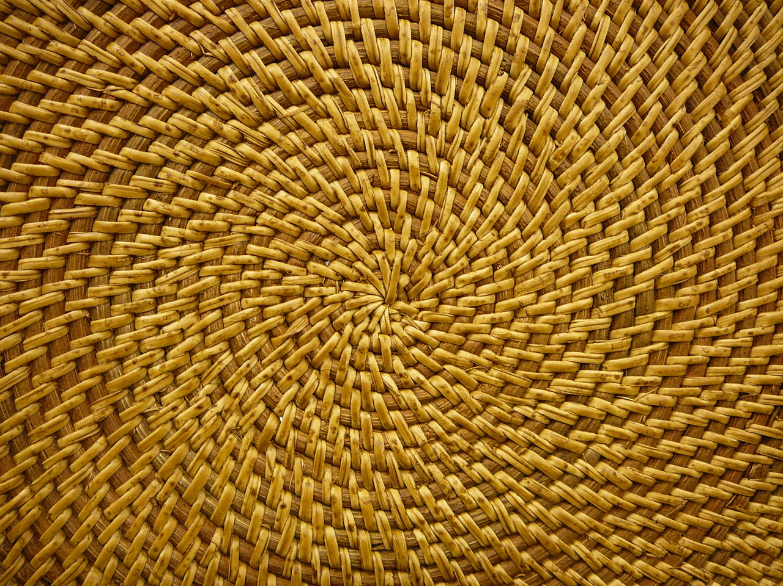

Slide 46
Implied texture expresses the idea of how a surface might feel. For example, a painting of a blanket might convey the idea that the blanket is soft.
Actual texture, on the other hand, is texture that can actually be felt. For example, a ceramic bowl might feature a carved texture that could be felt when holding that bowl.

Slide 47
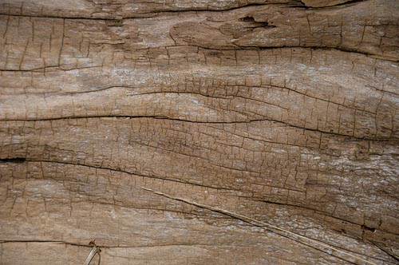
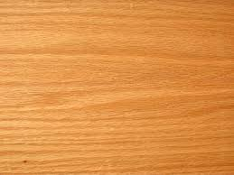
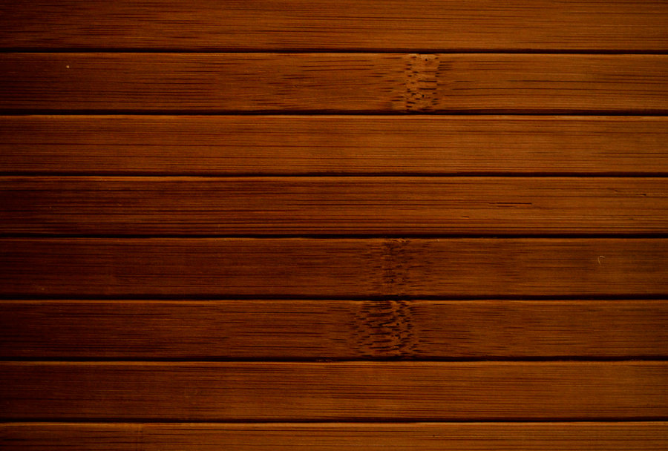
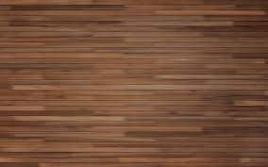
WOOD TEXTURE

Slide 48
PERSPECTIVE

Slide 49
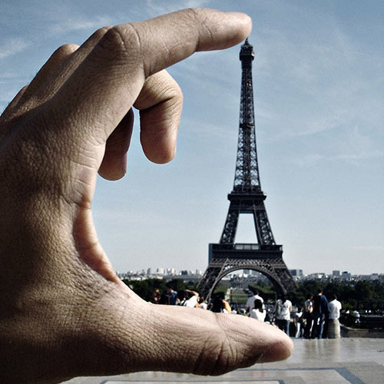
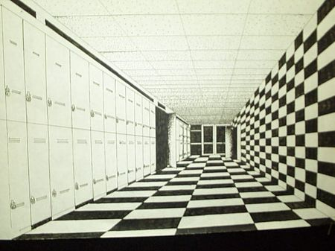
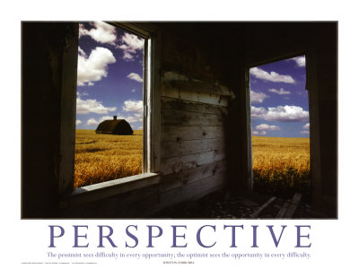

Slide 50
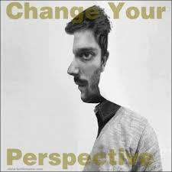

Slide 51
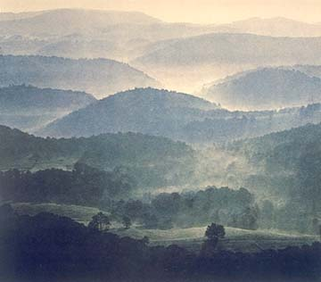
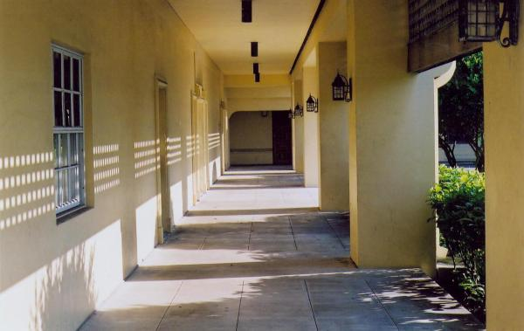
PERSPECTIVE
Perspective deals with the effect of distance upon the appearance of objects, by means of which the eye judges spatial relationships.

Slide 52
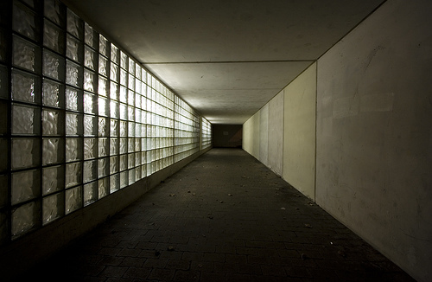
Kinds of Perspective
Linear perspective is the representation of an appearance of distance by means of converging lines.
It has to do with the direction of lines and with the size of objects.

Slide 53
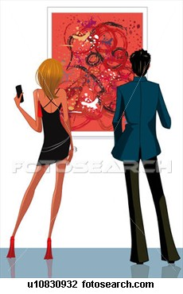
Linear Perspective
Painters usually show the effect of space and distance by using converging lines and diminishing size.
Parallel lines below the eye level seem to rise to a vanishing point in the horizon, while those above the eye level seem to descend to the vanishing point.
Foreshortening is the representation of objects or parts of the body as smaller from the point of view of the observer.

Slide 54
Kinds of Perspective
Aerial perspective is the representation of relative distances of objects by gradations of tone or color.
Objects become fainter in the distance due to the effect of the atmosphere. Objects appear to be lighter in color as they recede into the distance or atmosphere.

Slide 55
The Art Element of Space Space refers to how the artist fills the surface on which a work of art is created. It can also refer to the expression of depth within a work of art. When talking about a three-dimensional object, space is the actual volume that is taken up by the artwork.

Slide 56
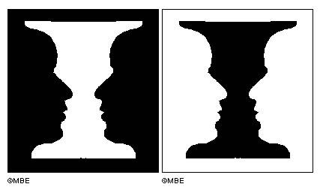
SPACE
Space as an element of art, refers to distances or areas around, between or within components of a piece.
Space can be positive (white or light) or negative (black or dark),open or closed, shallow or deep and two-dimensional or three-dimensional.
Sometimes space isn't actually within a piece, but the illusion of it is.

Slide 57
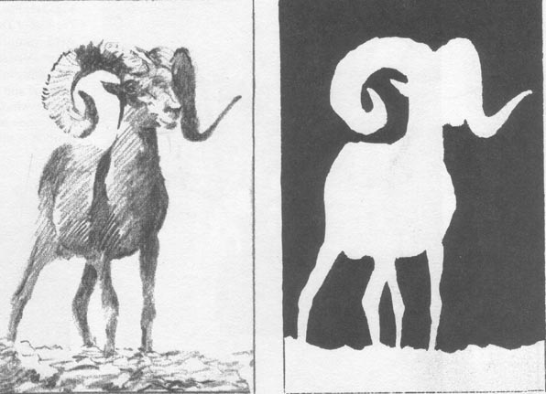
Kinds of Space
Positive space - the areas in a work of art that are the subjects, or areas of interest.
Negative space – areas around the subjects, or areas of interest.

Slide 58
Shape, Form, and Volume are words that are used to describe distinct areas or parts of works of art or architecture.

Slide 59
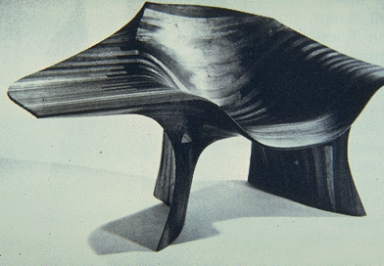
FORM
Form applies to the over-all design of a work of art.
It describes the structure or shape of an object.

Slide 60
The Art Element of Form Form refers to a three-dimensional object. As such, form is an art term that is only applied to those artworks that are three-dimensional, such as sculpture and pottery. Forms, much like shapes, can be geometric or organic. Geometric forms have hard lines and edges. Organic forms are curvy and more free-form.

Slide 61
Types of Form
Form and shape can also be described as either organic or geometric.
Organic forms such as these snow-covered boulders typically are irregular in outline, and often asymmetrical. Organic forms are most often thought of as naturally occurring.
Geometric forms are those which correspond to named regular shapes, such as squares, rectangles, circles, cubes, spheres, cones, and other regular forms.

Slide 62
Organic and Geometric Forms

Slide 63
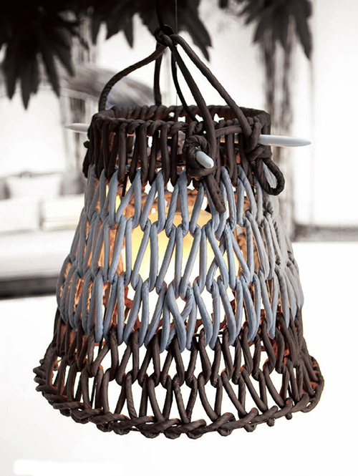
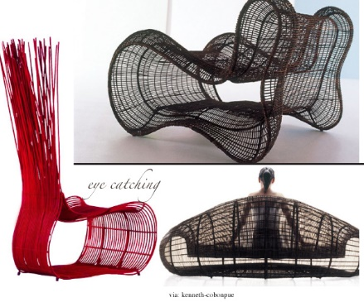
KENNETH COBONPUE’S
DESIGNS
Kenneth Cobonpue 's Knottee hanging lamp at Hive

Slide 64
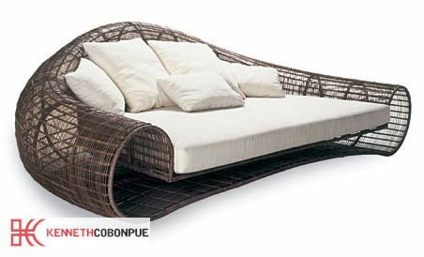
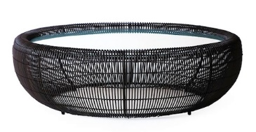
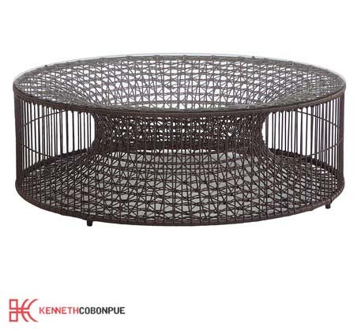
Croissant sofa
Croissant
Amaya CoffeeTable
Yin Yang Chair

Slide 65
VOLUME
Volume refers to the amount of space occupied in three dimensions.
It refers to solidity or thickness.

Slide 66
References:
Callow, R. (2014, January 21). Photo Gallery: Leading Lines in
Photography. Retrieved from http://blog.posterjack.ca/2014/01/21/
photo-gallery-leading-lines-in-photography/
Fichner-Rathus, L. (2010). Foundations of Art and Design. USA:
Thomson Learning Inc.
Rich, S. (2005, September 9). Kenneth Cobonpue. Design, Green
Furniture. Retrieved from http://inhabitat.com/kenneth-cobonpue/

Slide 67
TOPICS FOR HUMANITIES
ORIGIN OF ARCHITECTURE
ELEMENTS OF LITERATURE
MUSIC
COMBINATIONS OF INSTRUMENTS
DRAMA
DANCE

